Slide 1
CSCI 6521 Advanced Machine Learning I Chapter #2 LDA & QDA
Md Tamjidul Hoque

Slide 2
Objectives
Here we will extend our previous models for classification problems.
Approaches are similar to regression problem; however the outputs are broken into discrete ranges and labeled categorically:
Since our predictor G(x) takes values in a discrete set G, we can always divide the input space into a collection of regions labeled according to the classification.
For linear methods for classification, the decision boundaries are linear.

Slide 3
Idea(s) to Obtain Linear Decision Boundaries
First to fit linear regression models to the class indicator variables, and then to classify to the largest fit.
Let, there are K classes, labeled: 1, 2, …, k. The fitted linear model for the k^{th} indicator response variable can be:
The decision boundary between class k and ℓ is that set of points for which
, an affine set or hyperplane,
models discriminant functions for each class k.

Slide 4
Idea(s) to Obtain (Linear) Decision Boundaries …
We have seen posterior probabilities Pr(G = k | X = x) as a discriminating function – if it is linear in x, then the decision boundary will be linear as well.
if there are two classes, a popular model for the posterior probabilities is:

Slide 5
Idea(s) to Obtain Linear Decision Boundaries …
For our cancer example, we can also try drawing a decision boundary by a simple approach: Pr(B |X=x) = Pr(M|X=x)
load B.txt;
plot(B(:,1), B(:,2), 'o');
hold on;
load M.txt
plot(M(:,1), M(:,2), 'rx');
Mu0 = [1.1052 1.1286];
Mu1 = [2.0552 2.4578];
Sigma= [1.09229995 0.03073048;
0.03073048 1.29917801];
for i=-4:0.05:6,
for j=-4:0.05:6,
X= [ i j];
Px0 = mvnpdf(X,Mu0,Sigma);
Px1 = mvnpdf(X,Mu1,Sigma);
if abs(Px0 - Px1) <0.001 & Px0 > 0.01
plot(i,j, '.g');
end
end
end
Notes:
Since in both cases the priors are same (23/46 = 0.5, each), we just used likelihood to compute posterior.

Slide 6
Idea(s) to Obtain Linear Decision Boundaries …
If we take the log-odds or logit of them, we get:
The decision boundary is the set of points for which the log-odds are zero, and this is a hyperplane defined by { x | β₀ + β^{T} x = 0}.
We have two very popular but different methods that result in linear log-odds or logits:
linear discriminant analysis (LDA) and
linear logistic regression.

Slide 7
Idea(s) to Obtain Decision Boundaries
We will mostly be focusing linear decision boundaries in the lecture. However, there is considerable scope for generalization:
For example, we can expand our variable set X₁, …, X_{p} by including their squares and cross-products , , … , X₁X₂, …,
Linear functions in the augmented space map down to quadratic functions in the original space—hence linear decision boundaries to quadratic decision boundaries

Slide 8
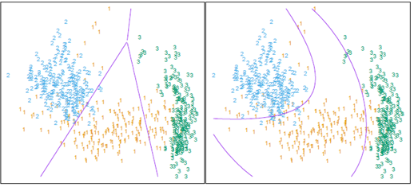
Idea(s) to Obtain Decision Boundaries
The left plot shows some data from three classes, with linear decision boundaries found by linear discriminant analysis

Slide 9
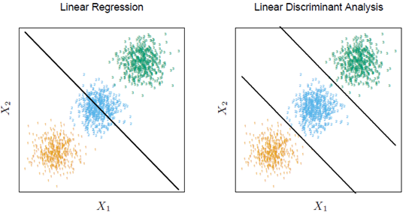
Linear Regression of an Indicator Matrix …
There is a serious problem with the regression approach when the number of classes K ≥ 3, especially prevalent when K is large.
Figure shows an extreme situation when K = 3. The three classes are perfectly separated by linear decision boundaries, yet linear regression misses the middle class completely.
Notes:
Note: The fundamental difference (and the difficulty with Linear Regression when K>=3 over LDA) is, the linear regression is passing through the center of the classes whereas LDAs are passing around the border of the classes by the nature of their constructions.

Slide 10
Linear Regression of an Indicator Matrix …
For this simple example a quadratic rather than linear fit (for the middle class at least) would solve the problem.
However, it can be seen that if there were four rather than three classes lined up like this, a quadratic would not come down fast enough, and a cubic would be needed as well.
A loose but general rule is that if K ≥ 3 classes are lined up, polynomial terms up to degree (K − 1) might be needed to resolve them.

Slide 11
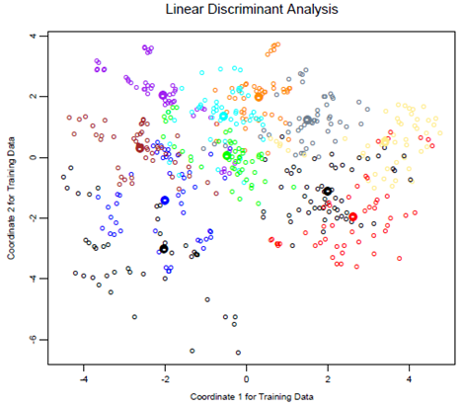
LDA for a Complex Problem
However, for large K and small p such maskings naturally occur.
The figure is a projection of the training data for a vowel recognition problem onto an informative two-dimensional subspace.
There are K = 11 classes in p = 10 dimensions, of which three account for 90% of the variance.
This is a difficult classification problem

Slide 12
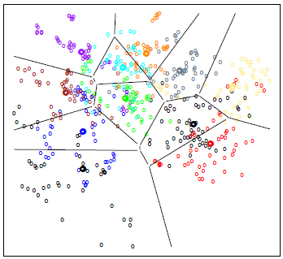
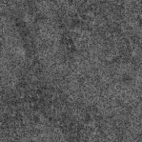
LDA for a Complex Problem …
However, for large K and small p such maskings naturally occur.
The figure is a projection of the training data for a vowel recognition problem onto an informative two-dimensional subspace.
There are K = 11 classes in p = 10 dimensions, of which three account for 90% of the variance.
This is a difficult classification problem

Slide 13
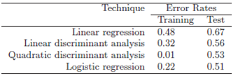
Performance Comparisons
Training and test error rates using a variety of linear techniques on the vowel data.
There are eleven classes in ten dimensions, of which three account for 90% of the variance.
We see that linear regression is hurt by masking, increasing the test and training error by over 10%.

Slide 14
Overview of the Next Parts of the Presentation
We will mostly cover by chalk and talk for the derivations of the following approaches:
Linear Discriminant Analysis (LDA)
Quadratic Discriminant Analysis (QDA)
Logistic Regression (Logistic Classification)

Slide 15
Linear Discriminant Analysis
Decision theory for classification (Section 2.4) tells us that we need to know the class posteriors Pr(G|X) for optimal classification.
Suppose f_{k}(x) is the class-conditional density of X in class G = k
let π_{k} be the prior probability of class k, with ∑ π_{l}=1.
Bayes theorem gives us:

Slide 16
Linear Discriminant Analysis …
In comparing two classes k and ℓ, it is sufficient to look at the log-ratio, and we see that:
Here we assumes, that we model each class density as multivariate Gaussian, that is:
we see that the linear discriminant functions

Slide 17
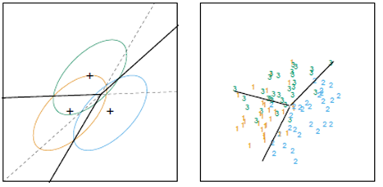
Linear Discriminant Analysis …
The left panel shows three Gaussian distributions, with the same covariance and different means.
Included are the contours of constant density enclosing 95% of the probability in each case.
The Bayes decision boundaries between each pair of classes are shown (broken straight lines), and the Bayes decision boundaries separating all three classes are the thicker solid lines (a subset of the former).
Notice that the decision boundaries are not the perpendicular bisectors of the line segments joining the centroids. This would be the case if the covariance were spherical σ²I, and the class priors were equal.
On the right we see a sample of 30 drawn from each Gaussian distribution, and the fitted LDA decision boundaries.

Slide 18
Quadratic Discriminant Analysis …
If the are not assumed to be equal, then the pieces quadratic in x remain. We then get quadratic discriminant functions:
The decision boundary between each pair of classes k and ℓ is described by a quadratic equation:

Slide 19
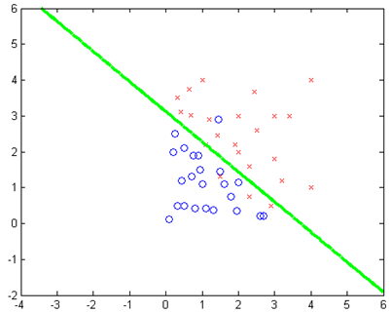
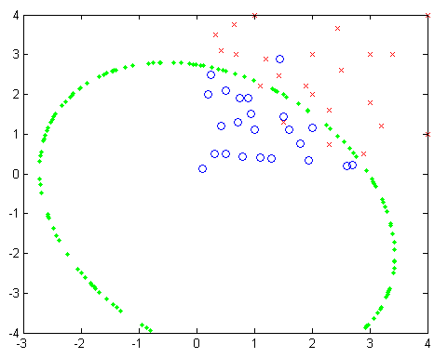
Cancer Dataset : LDA versus QDA
We can implement LDA and QDA for our cancer example (see the EXERCISE_Chapter_5_Classification and the data section for details):
LDA
QDA

Slide 20
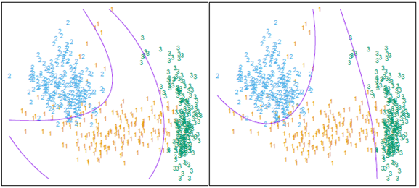
LDA in Augmented (Quadratic) space Versus QDA
LDA …
QDA
The right plot shows the quadratic decision boundaries found by QDA.
The differences are small, as is usually the case.
QDA is the preferred approach, with the LDA method a convenient substitute.

Slide 21
LDA versus QDA
The estimates for QDA are similar to those for LDA, except that separate covariance matrices must be estimated for each class.
When p is large this can mean a dramatic increase in parameters. For K classes there will be
there are (K − 1) × (p + 1) parameters for LDA.
there will be (K − 1) × {p (p + 3)/2 + 1} parameters for QDA.
Both LDA and QDA perform well on an amazingly large and diverse set of classification tasks.
why LDA and QDA have such a good track record?
the data can only support simple decision boundaries such as linear or quadratic, and the estimates provided via the Gaussian models are stable.

Slide 22
Logistic Regression (Classification)
Logistic regression is widely used because:
it is easy to build and it is easy to use
it is easy to interpret
In terms of complexity, parameters remain proportional to the input features, therefore, complexity remain simple while the number of input feature increases.
we are trying to model

Slide 23
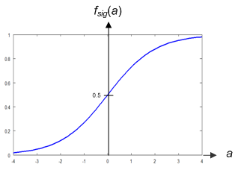
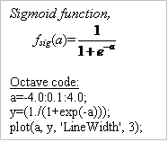
… Logistic Regression (Classification)
From our previous experience, we can express our linear equation as:

Slide 24
… Logistic Regression (Classification)

Slide 25
Logistic Regression
Steps (7 steps here) in finding the decision boundary for the cancer data:

Slide 26
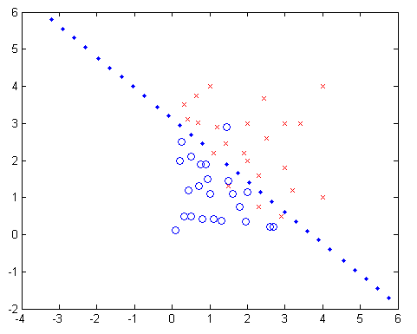
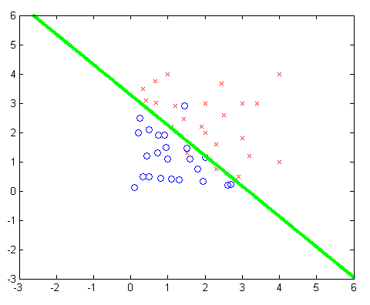
Various Boundaries (for Cancer Data)
Linear Reg. with Indicator Fn.
LDA
QDA
Logistic Reg.

Slide 27
Various Boundaries (for Cancer Data)
Comparing LDA, QDA and LR by superimposing
-------- x ----------
Notes:
%================================= LDA below: //////////
load B.txt;
plot(B(:,1), B(:,2), 'o');
hold on;
load M.txt
plot(M(:,1), M(:,2), 'rx');
hold on;
Mu0 = [1.1052; 1.1286]; % Now using as a column vector
Mu1 = [2.0552; 2.4578]; % Now using as a column vector
Sigma= [1.09229995 0.03073048; 0.03073048 1.29917801];
for i=-4:0.01:6,
for j=-4:0.01:6,
X= [ i j]; % This is already X_transpose
Delta0 = X* inv(Sigma)* Mu0-0.5* Mu0' *inv(Sigma)* Mu0+0.5;
Delta1 = X* inv(Sigma)* Mu1-0.5* Mu1' *inv(Sigma)* Mu1+0.5;
if abs(Delta0 - Delta1) <0.001
plot(i,j, '.g');
end
end
end
%=========================== QDA below: ============
Mu0 = [1.1052; 1.1286]; % Now using as a column vector
Mu1 = [2.0552; 2.4578]; % Now using as a column vector
Sigma0= [0.551981 -0.18298; -0.18298 0.636703];
Sigma1= [1.210508 -0.3869; -0.3869 1.097263];
for i=-4:0.01:6,
for j=-4:0.01:6,
X= [ i j]; % This is already X_transpose
QDelta0 = -0.5*log(det(Sigma0))- 0.5*(X'-Mu0)'*inv(Sigma0)* (X'-Mu0)+0.5;
QDelta1 = -0.5*log(det(Sigma1))- 0.5*(X'-Mu1)'*inv(Sigma1)* (X'-Mu1)+0.5;
if abs(QDelta0 - QDelta1) <0.001
plot(i,j, '.b');
end
end
end
%============== LR below=========
load X.txt
[N,M]=size(X);
load Y_LR.txt
Beta=zeros(M,1);
W=eye(N,N);
eta=zeros(N,1); % Column vector with N zeros
for j=1:10
for i=1:N
x=X(i,:)';
p=exp(x'*Beta)/(1+exp(x'*Beta));
eta(i)=p;
p=p*(1-p);
W(i,i)=p;
end
9
z=(X*Beta+inv(W)*(Y_LR-eta));
Beta=inv(X'*W*X)*X'*W*z
end
for i=-4:0.005:6,
for j=-4:0.005:6,
Y1=-11.0599 +3.4993*i+3.3708*j;
if abs(Y1) <0.001
plot(i,j, '.k');
end
end
end

